Slide 1
Anti-theft Security Lock
Presented by: S M tusher mustakim
ID: 19-40861-2

Slide 2
Outline
Introduction
Methodology
Result & Discussion
Conclusion
Reference

Slide 3
Introduction
What is digital security
How it works
What is a electronic device
Where it can be found

Slide 4
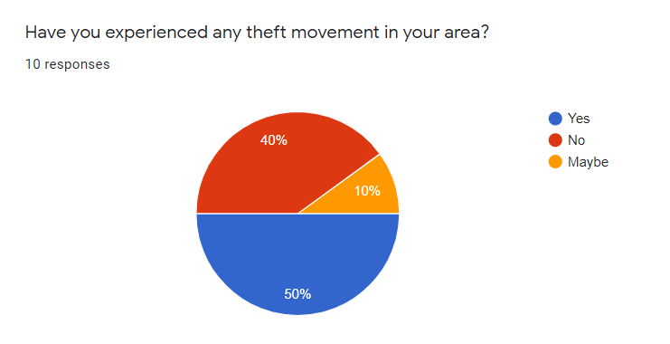
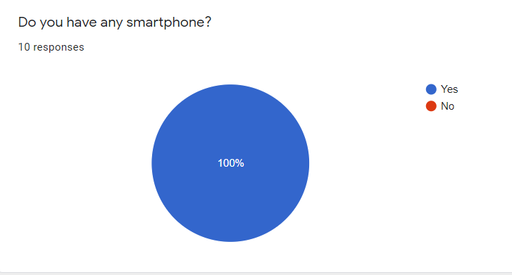
Methodology
Primary data collected
Several questions was asked
Type of questions
Responding
Percentages

Slide 5
Result & Discussion
Security of house or workshop
Installation
App usage
Emergency situations

Slide 6
Conclusion
Need to know how to use mobile apps
Internet connectivity
Suggestions to researchers
Availability of electronic devices

Slide 7
Reference
Electronic devices availability: https://www.nationmaster.com/nmx/ranking/electrical-equipment-and-electronics-output
Mobile app user in Bangladesh: http://www.internationaljournalssrg.org/IJMCA/paper-details?Id=22
Theft percentage in Bangladesh(Bangladesh Police): https://www.police.gov.bd/en/crime_statistic/year/2019

Slide 8
Any Question ?

